Slide 1
Unit 4 lecture 8

Slide 2
4E: Writing task
Writing an online review

Slide 3
Read the online review of an exhibition by a recent visitor to London. Would you follow the recommendation? Why?

Slide 4
I find that it’s always worth checking out the parks when you visit a foreign city. Besides providing a welcome break, they can contain some interesting surprises. Last week, exhausted from visiting two museums and too tired even to think about shopping anymore, my friend and I took a walk in Kensington Gardens. I was so glad we did, because otherwise we’d have missed Anish Kapoor’s mirror sculptures. There are four of them, and rather than looking out of place as so many modern sculptures can, these really complemented their surroundings. Sky Mirror, as its name suggests, is placed at an angle to reflect the changing sky. Another, Red Mirror, is also directed at the sky but has a red tint. The one I liked best was the C-Curve, a convex mirror that makes you see everything upside down. It was so funny to watch dogs and children approach it, trying to figure out what they were looking at. The secret of this exhibition’s success is that it makes you appreciate what is already a lovely park even more. It will be on display until March 30th. I’d definitely recommend taking the time to go and see it for yourself if you’re in London. What’s more, it’s free

Slide 5
How are the following themes organized in the review? Put them in order (1–5).
the recommendation
an introduction
the content of the exhibition
the occasion of the visit
where and when it is on

Slide 6
What information about the event does she include?
Is the tone of the review personal or impersonal?

Slide 7
Personal tone
Work in pairs. Look at the following features of personal and impersonal writing. Then find examples of the personal tone in the review.
use pronouns
use active verbs
use contracted forms
use phrasal verbs
add personal details
use conversational linking phrases (like what’s more)
share your feelings

Slide 8
Impersonal tone
use pronouns
use passive verbs
use uncontracted forms
use formal verbs
avoids personal information
use formal linking phrases (like furthermore)
be objective in your judgments

Slide 9
A writing task
Write a brief, personalized review of something for a website. Then exchange your review with another person in the class.

Slide 10
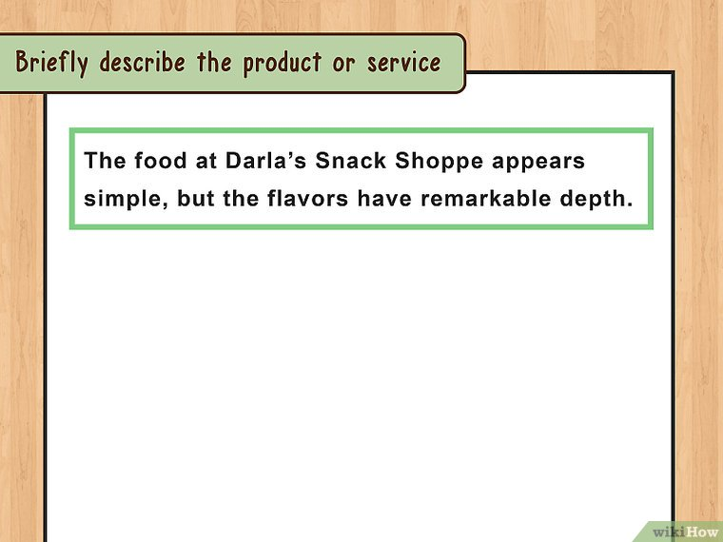
How to write an online review

Slide 11
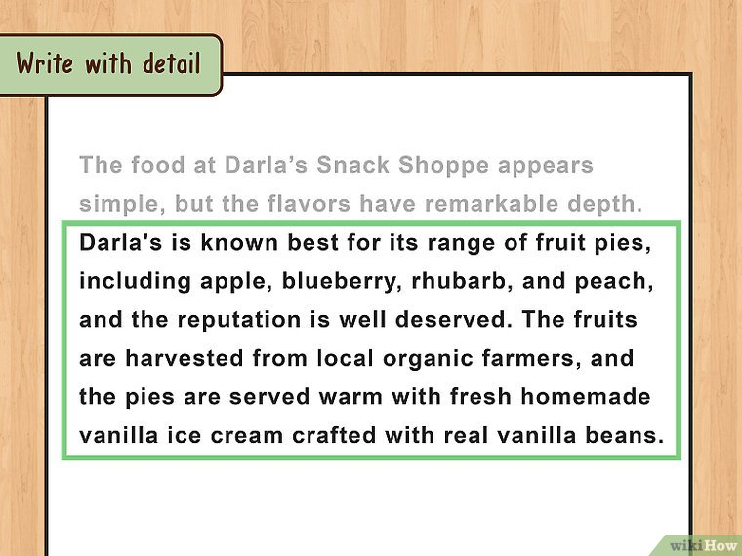

Slide 12
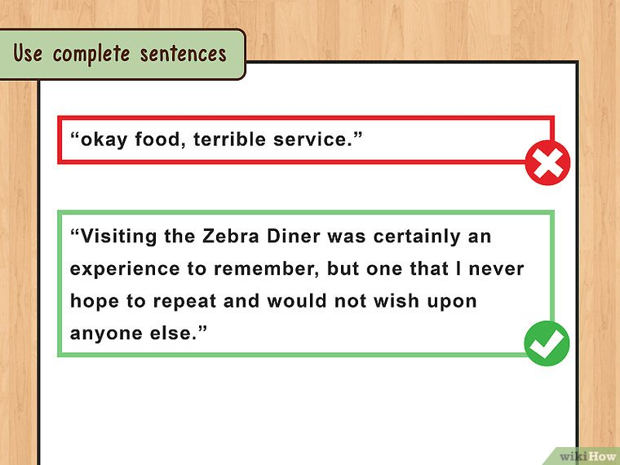

Slide 13
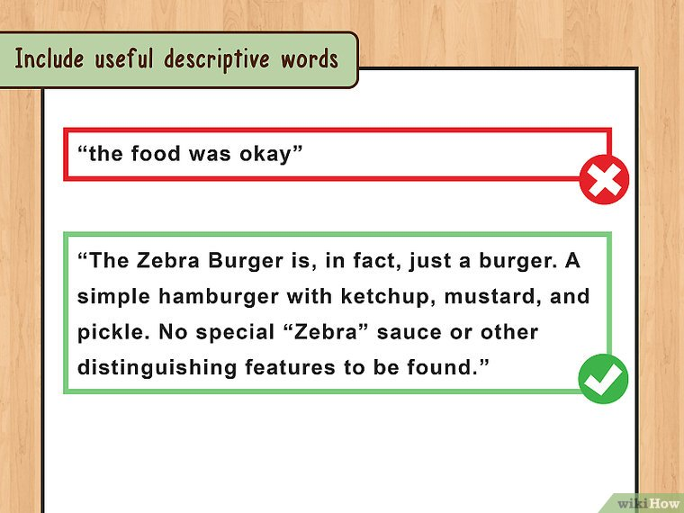

Slide 14
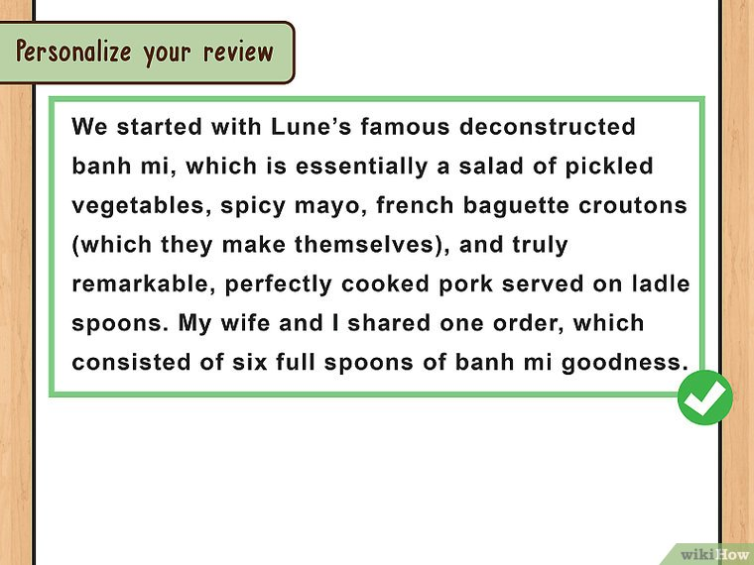

Slide 15
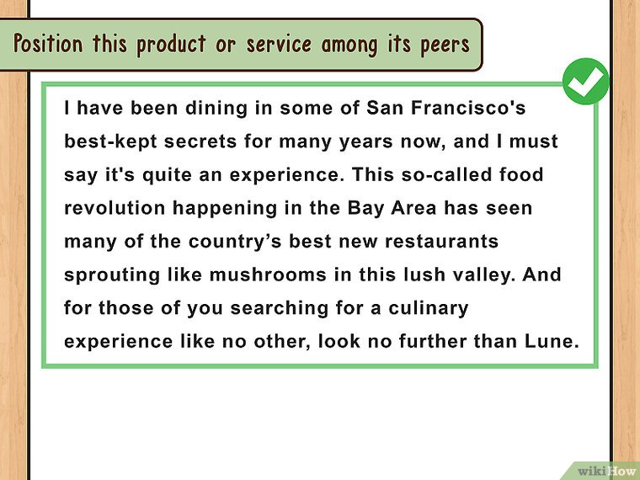

Slide 16
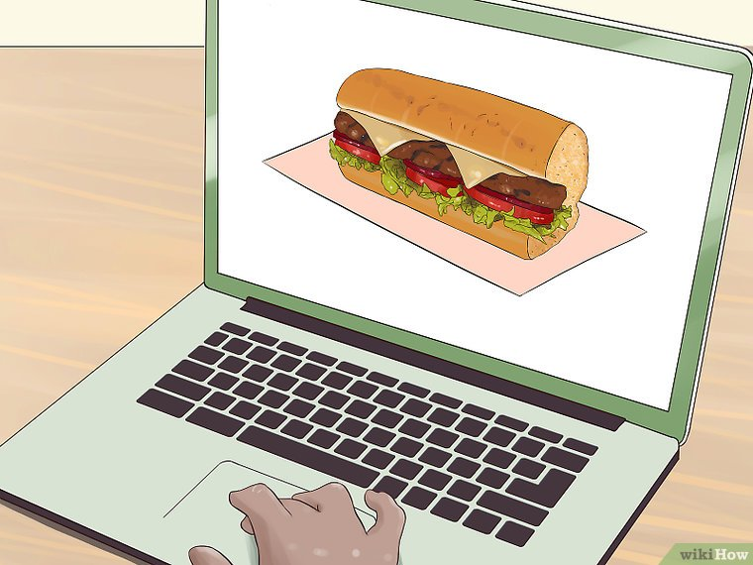

Slide 17
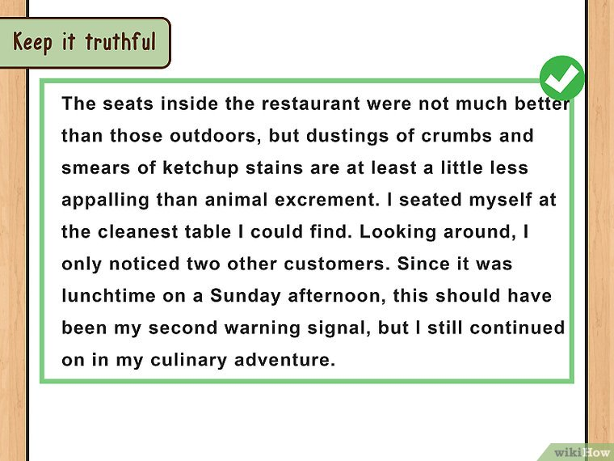

Slide 18
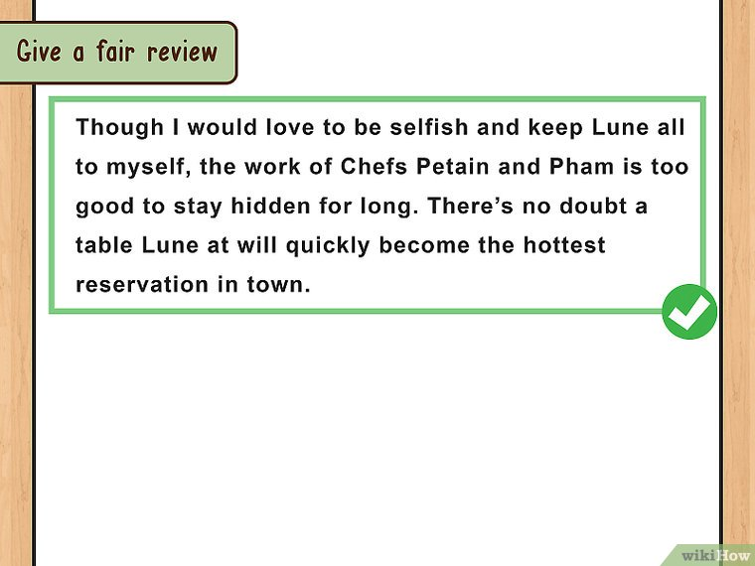

Slide 19
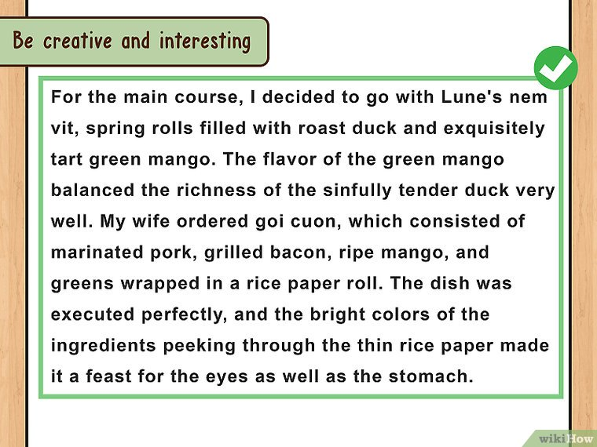

Slide 20
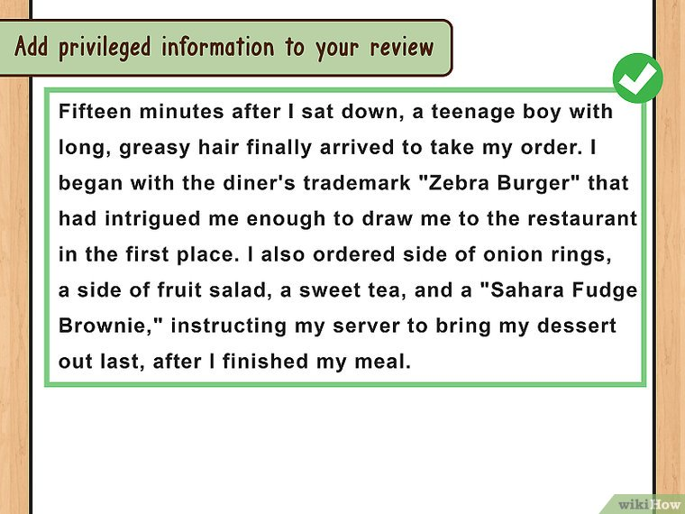

Slide 21
